Slide 1

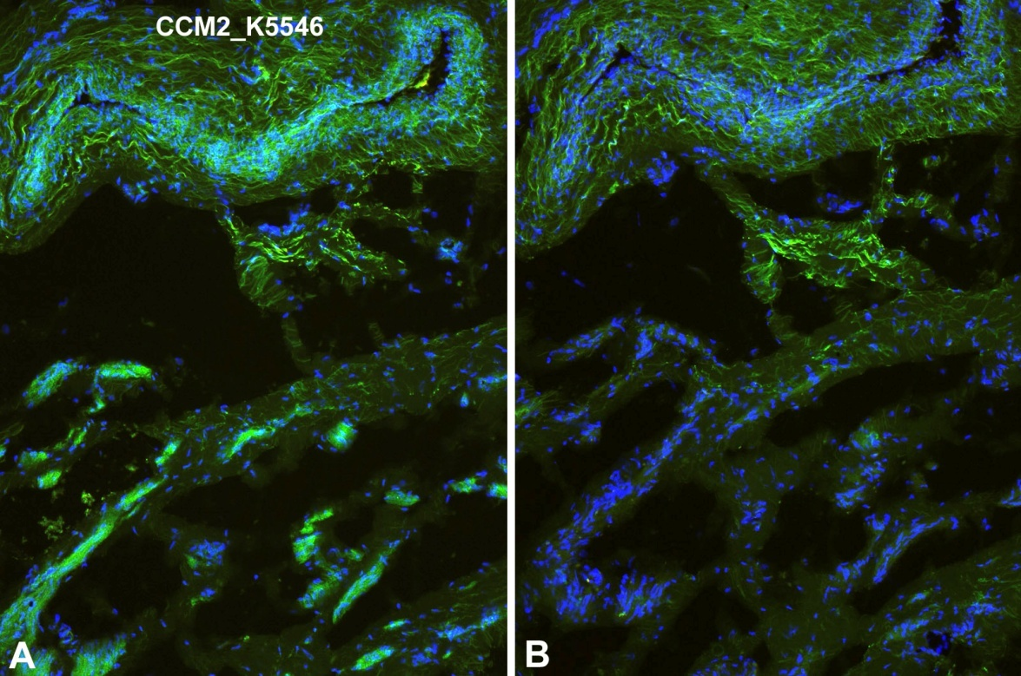
ReliaTech GmbH
Rabbit anti-human CCM2
„Cerebral cavernous malformations 2 protein “
(Cat #102-PA26S/-PA26)
Immunofluorescence staining (green) of human foreskin (cryo-section of unfixed tissue) with anti-human CCM2 (K5546; dilution 1:50) [Cat# 102-PA26]. A) Note specific staining in the wall of microvessels. B) Negative control of a consecutive section. Note non-specific fluorescence in elastic fibres in the adventitia of an arteriol. Nuclei counter-stained with Dapi (blue). Specimen provided by Prof. Dr. J. Wilting, Goettingen.
The experiment was performed by the research group of Prof. Dr. J. Wilting, University Göttingen, Germany.
http://www.reliatech.de / orders@reliatech.de

